Slide 1
Secure data hiding in images using steganography
CAPSTONE PROJECT
Presented By:
Student Name : Malay Vishwakarma
College Name & Department : Ashoka Institute of Technology and Management Varanasi & Computer Science and Engineering

Slide 2
OUTLINE
Problem Statement
Technology used
Wow factor
End users
Result
Conclusion
Git-hub Link
Future scope

Slide 3
Problem Statement
In today’s digital world, secure communication is crucial.
Traditional encryption techniques can be detected, leading to potential attacks.
There is a need for an invisible way to hide sensitive data within digital media.
Steganography provides a method to embed information inside images, ensuring secrecy.

Slide 4
Technology used
Programming Language: Python
Libraries:
OpenCV (cv2) for image processing
NumPy for data handling
Algorithms:
LSB (Least Significant Bit) technique for embedding data in images
Secure password authentication
File Handling: Image manipulation using .png and .jpg formats

Slide 5
Wow factors
Data is hidden inside images without visible changes.
Unlike encryption, steganography makes the message undetectable.
Dual-Layer Security : Supports password-protected decryption with Steganography for added security.
Useful for secure communication in cybersecurity and intelligence agencies.
Practical demonstration: Encrypt and decrypt secret messages in an image.

Slide 6
End users
Cybersecurity Experts – Secure data exchange
Government & Military – Confidential communication
Journalists & Whistleblowers – Secure news transmission
Data Forensics Teams – Covert investigation methods
General Users – Personal data security in images

Slide 7
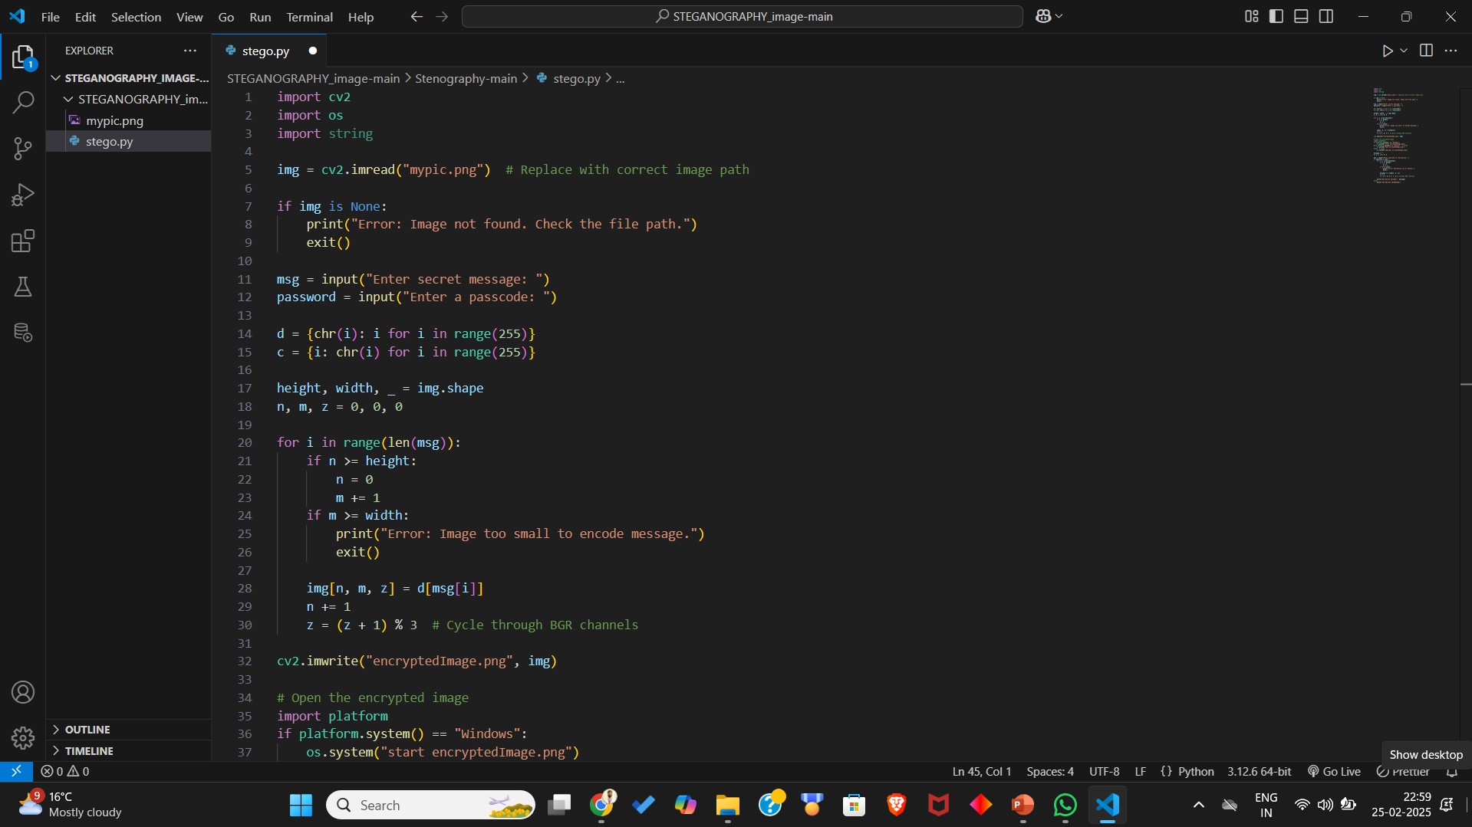
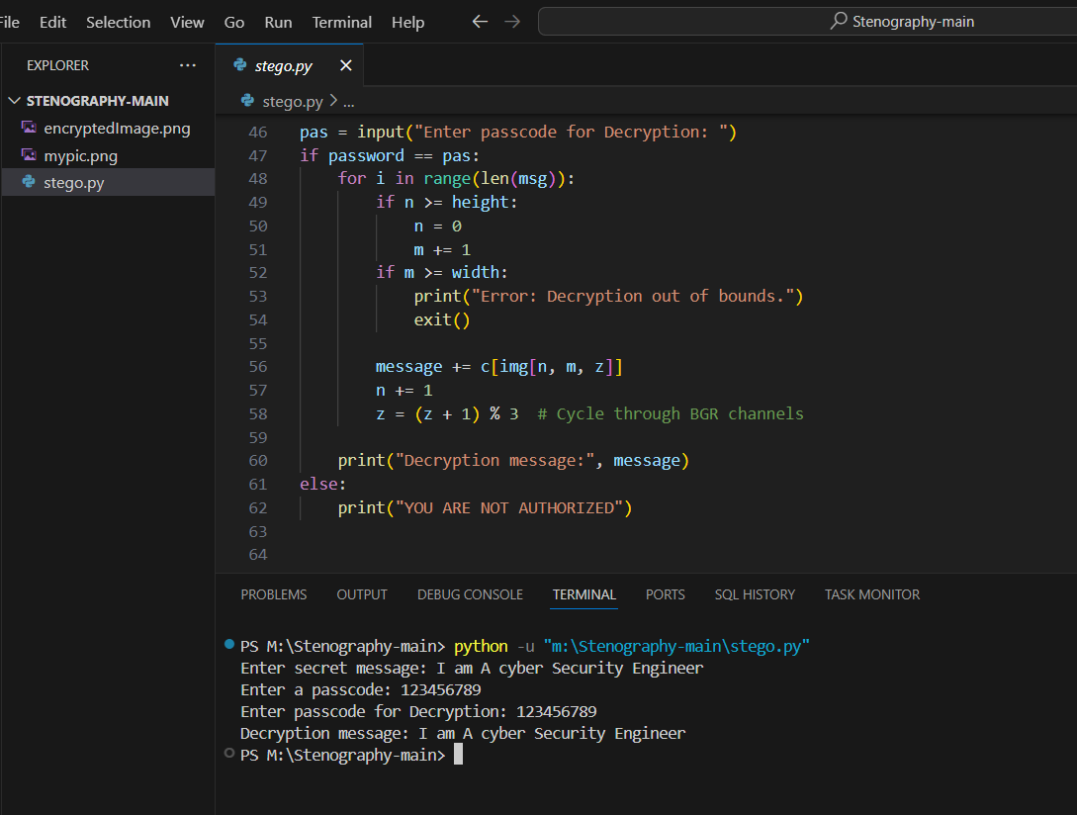
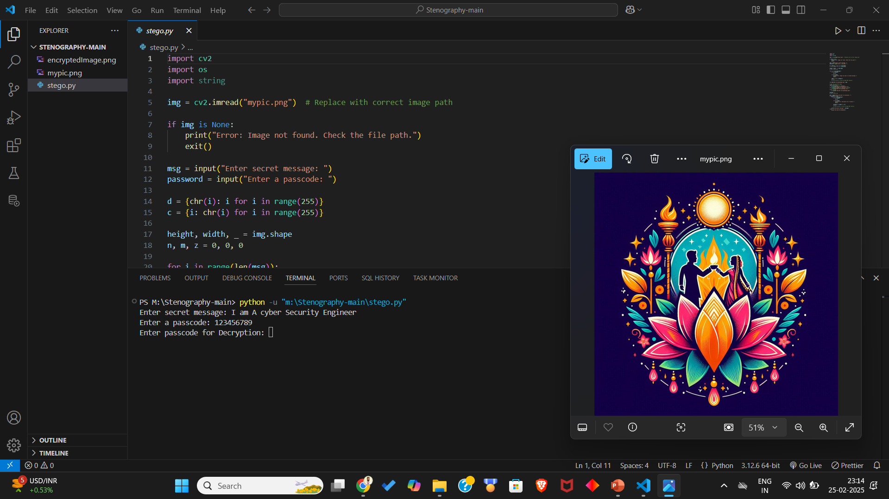
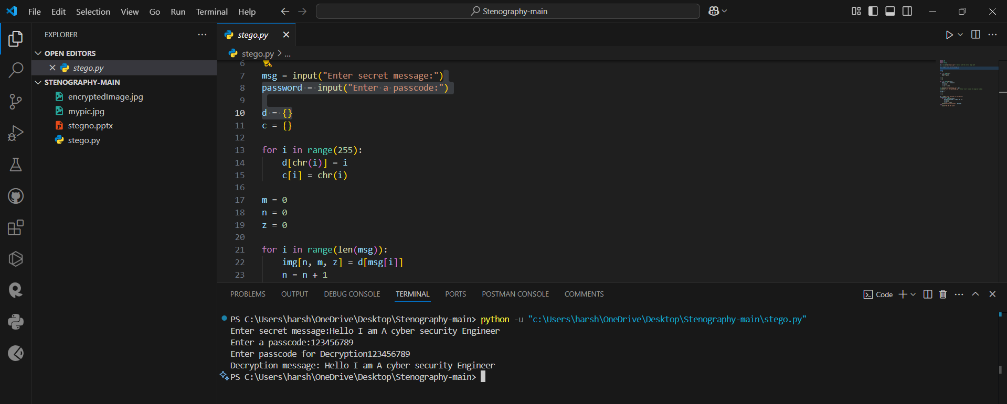
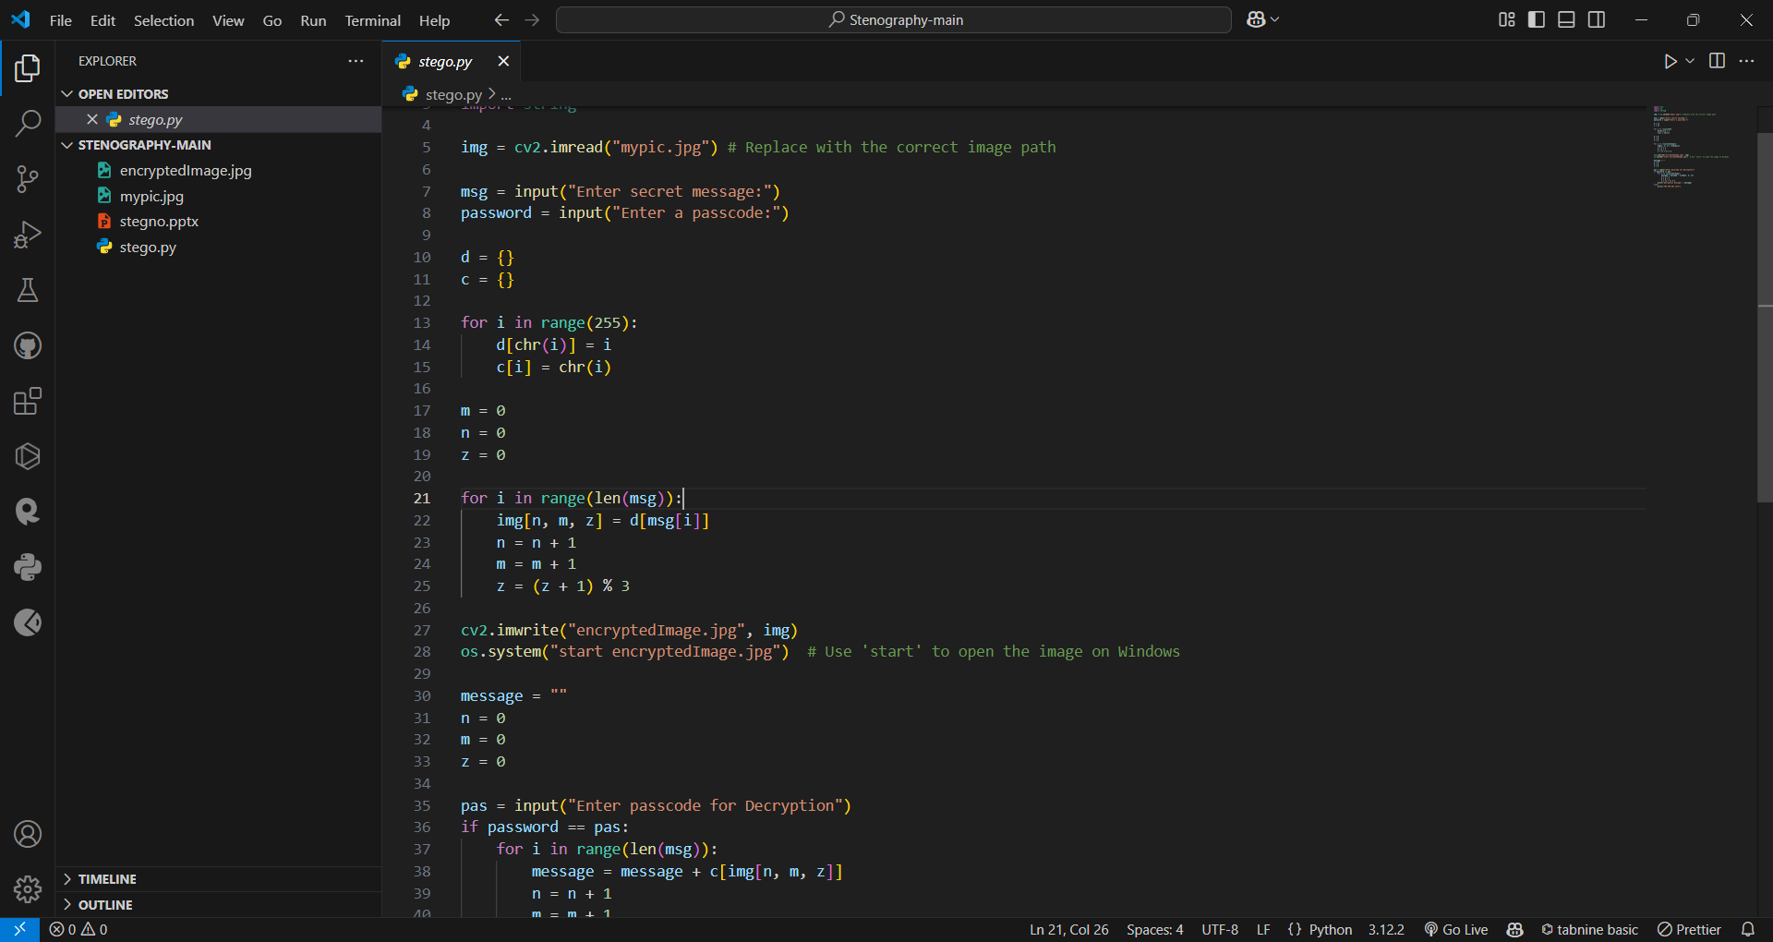
Results

Slide 8
Conclusion
Steganography enhances digital security by embedding secret data inside images.
The LSB technique provides efficient and undetectable data hiding.
The project shows potential for real-world applications in secure communication.
Future improvements can include higher capacity encoding and multi-format support.

Slide 9
GitHub Link
Make sure that there should be readme file : https://github.com/malayvish/Stenography-main.git

Slide 10
Future scope(optional)
Increase Security: Implement AES/RSA encryption along with steganography.
Video & Audio Steganography: Expand the project to multimedia.
Machine Learning: Detect and prevent steganalysis attacks.
Cloud Integration: Secure cloud-based steganographic data transfer.

Slide 11
THANK YOU

